Slide 1
Codec newbies:
how to build a crappy lossless audio codec

Slide 2
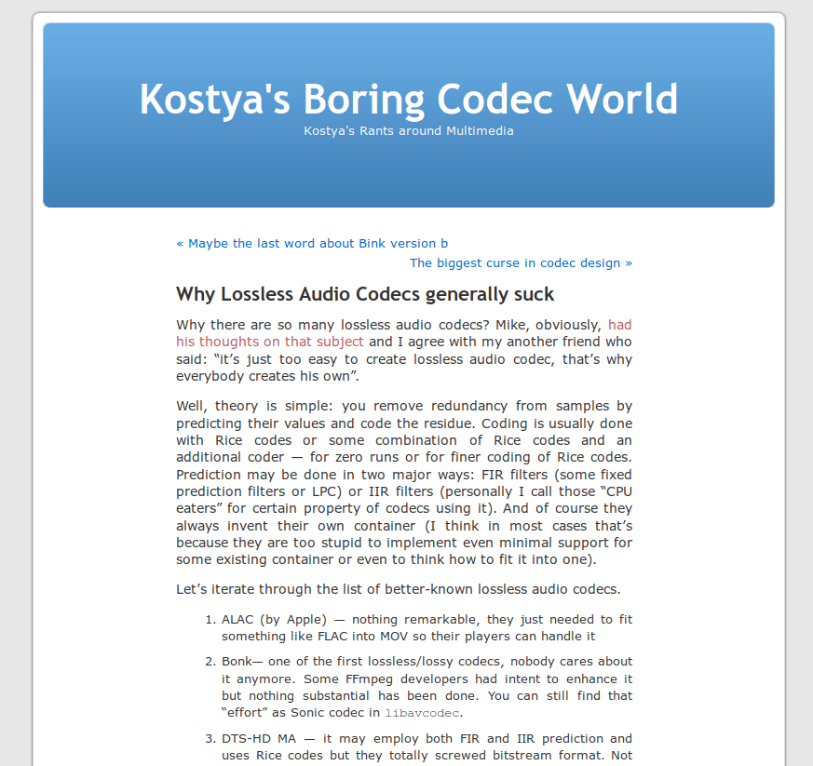
https://codecs.multimedia.cx/2010/11/why-lossless-audio-codecs-generally-suck/

Slide 3
What is sound?
Audible wave of pressure, through a transmission medium (air)

Slide 4
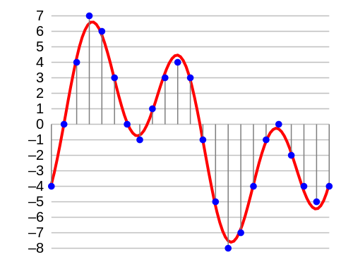
In a computer?
Must be quantized to be stored inside a computer.
  Linear Pulse-Code Modulation (PCM)
Sampling frequency:
number of values per second
(ex: 44100 Hz, 48000Hz)

Slide 5
Storing sound
As an array:
  Of integer values
  (16 bit, 32 bit ...)
  ex: [-4, 0, 4, 7, 6, 3 …]
  Or float values
  (32 bit)
Uncompressed format:
  ex: Microsoft Wave Format

Slide 6
But this take space…
Let’s compute the size!
Track to encode:
  3 minutes songs,
  Stereo: 2 channels,
  Sampling: 44100 Hz,
  Format: 16 bit integer.
Size:
  3 * 60 * 2 * 44100 * 2
  = 30.28 MB !

Slide 7
So...
Compression can be useful!
  Lossy
    Decompression do not restore the original discretized wave.
    Tradeoff between data size and quality.
    Ex: MP3, AAC…
  Lossless
    Decompression does restore the original discretized wave.
    FLAC, ALAC, ALS...

Slide 8
CLAC : Crappy Lossless Audio Codec

Slide 9
Cut the input wave into frames
For random access.
  Decompress them independently
Optimize the compression parameters to each frame.
Example frame sizes: 512, 1024, 2048...

Slide 10
Any idea?

Slide 11
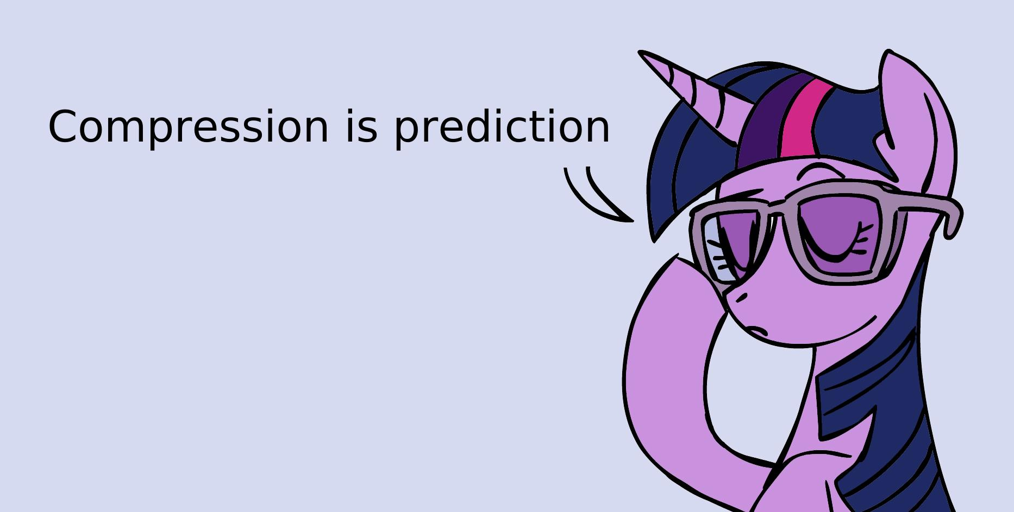

Slide 12
Compression is prediction
Guess what the next data will be!
Encode the difference between the prediction and the signal.
Predictor accurate most of the time,
→ small prediction errors,
→few bits needed to encode them.
Challenges:
  1. Find the best predictor.
  2. Encode efficiently the prediction error.

Slide 13
1. Find the best predictor
Linear predictor
  p(t) = s(t – 1)
  p(t) = 2 * s(t – 1) – s(t – 2)
  p(2) = 2 * s(1) – s(0)
  p(2) = 2 * -4 – 0 = 4
  LPC...
How to find the best predictor ?

Slide 14
Linear predictive coding (LPC)
Widely used for lossless sound coding (Shorten, FLAC, MPEG-4 ALS...)
Basic idea: current value can be closely approximated as a linear combination of past samples.
How the get the αk values?
  Levinson-Durbin algorithm,
  Must encode the αk in the compressed signal (actually partial coefficients).
How to choose the order?
p(t): predicted value
s(t): wave signal
o: predictor order

Slide 15
Measure predictor efficiency
X: the prediction signal to compress (n symbols)
Compute
  The compressed signal
    The most accurate but slow
  Shannon entropy
    “Average amount of information produced by a probabilistic stochastic source of data” (Wikipedia)
    Theoretical limit of the signal compression rate
    Good predictor but slow
  Flac encoder method ???

Slide 16
  2. Encode the prediction error
Entropy coding
  Lossless data compression scheme
  Replace fixed length input symbol with a corresponding variable-length output codeword.
  Aim: frequent symbols have a small size codeword.
  Huffman coding
  Arithmetic coding
    Range coding

Slide 17
Range coding example
Encode a symbol sequence with a very big integer.
Example (from Wikipedia):
  Thee symbols: A, B, X (end of message).
  AABAX (10⁵ combinations)
  Symbol probabilities:
    A: 0.60
    B: 0.20
    X: 0.20

Slide 18
Range coding example
Initial range: [0, 100000]
1. Symbol A
  A: [0, 60000)
  B: [60000, 80000)
  X: [ 80000, 100000)
2. Symbol A
  AA: [0, 36000)
  AB: [36000, 48000)
  AX: [48000, 60000)
3. Symbol B
  AAA: [0, 21600)
  AAB: [21600, 28800)
  AAX: [28800, 36000)
4. Symbol A
  AABA: [21600, 25920)
  AABB: [25920, 27360)
  AABX: [27360, 28800)

Slide 19
Range coding example
5. Symbol X
  AABAA: [21600, 24192)
  AABAB: [24192, 25056)
  AABAX: [25056, 25920)
“251”: 3 digits prefix than fit in our final range
How to select a big enough initial range?
  Does not matter.
  Remove from our currant range the left-most digits that won’t change.

Slide 20
Probability distribution
The range encoder/decoder need a symbol distribution.
How to transmit it to the decoder?
  Save it in the stream?
    Way too big!
  Estimate it with few parameters
    Transmit them in the stream.
Alternative method: use an adaptive distribution
ex. of LPC distribution

Slide 21
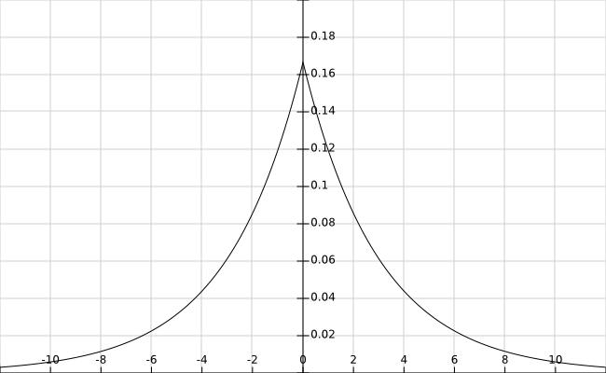
Finding distribution parameters
Laplace distribution
Parameter estimation
Transmit b value in the compressed data
b=3

Slide 22
Demo

Slide 23
Remarks
CLAC is very limited:
  16 bit integer PCM,
  Does not support multi-channel,
  Does not store meta-data,
  Has a single predictor,
  Is not secure.
CLAC is slooooowwwwww…
  Not optimized at all

Slide 24
And remember…
Thank you!

Slide 25
Bibliography
Robinson, Tony. "SHORTEN: Simple lossless and near-lossless waveform compression." (1994).
https://en.wikipedia.org/wiki/Range_encoding
https://en.wikipedia.org/wiki/Laplace_distribution
Liebchen, Tilman, et al. "The MPEG-4 Audio Lossless Coding (ALS) standard-technology and applications." Proc. 119th AES Conv. 2005.

